Slide 1
Basic Proof Techniques
[Direct Proofs – Common Mistakes in Proofs ]
Aamir Shahzad Hashmi

Slide 2
The Proof Process
Assumptions
-Definitions
-Already-proved equivalences
-Statements (e.g., arithmetic or algebraic)
Logical Steps
Conclusion
(That which was to be proved)

Slide 3
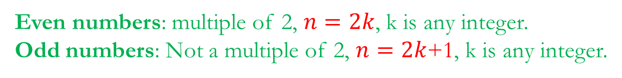

Direct Proof (1)
Give a proof of the statement, “If $n$ is an even number, then $n^{2}$ is also even’’
Proof:
Even numbers: multiple of 2, $n=2k$, k is any integer.
Odd numbers: Not a multiple of 2, $n=2k$+1, k is any integer.

Slide 4

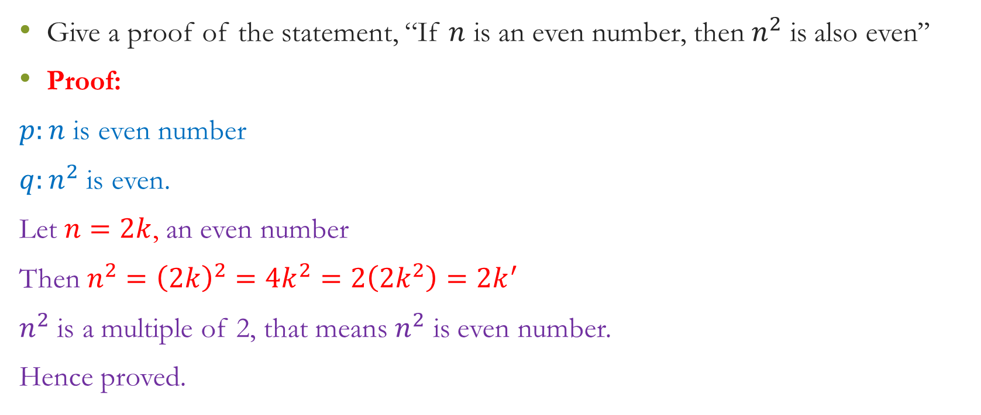
Direct Proof (1)
Give a proof of the statement, “If $n$ is an even number, then $n^{2}$ is also even’’
Proof:
$p:n$ is even number
$q:n^{2}$ is even.
Let $n=2k$, an even number
Then $n^{2}={\left(2k\right)}^{2}=4k^{2}=2\left(2k^{2}\right)=2k^{′}$
$n^{2}$ is a multiple of 2, that means $n^{2}$ is even number.
Hence proved.
Even numbers: multiple of 2, $n=2k$, k is any integer.
Odd numbers: Not a multiple of 2, $n=2k$+1, k is any integer.

Slide 5
Direct Proof (2)
Proof:

Slide 6
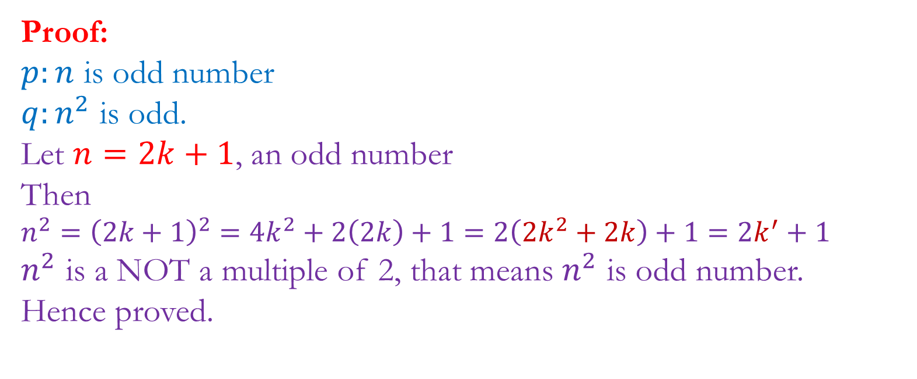
Direct Proof (2)
Proof:
$p:n$ is odd number
$q:n^{2}$ is odd.
Let $n=2k+1$, an odd number
Then
$n^{2}={\left(2k+1\right)}^{2}=4k^{2}+2\left(2k\right)+1=2\left(2k^{2}+2k\right)+1=2k^{′}+1$
$n^{2}$ is a NOT a multiple of 2, that means $n^{2}$ is odd number.
Hence proved.

Slide 7
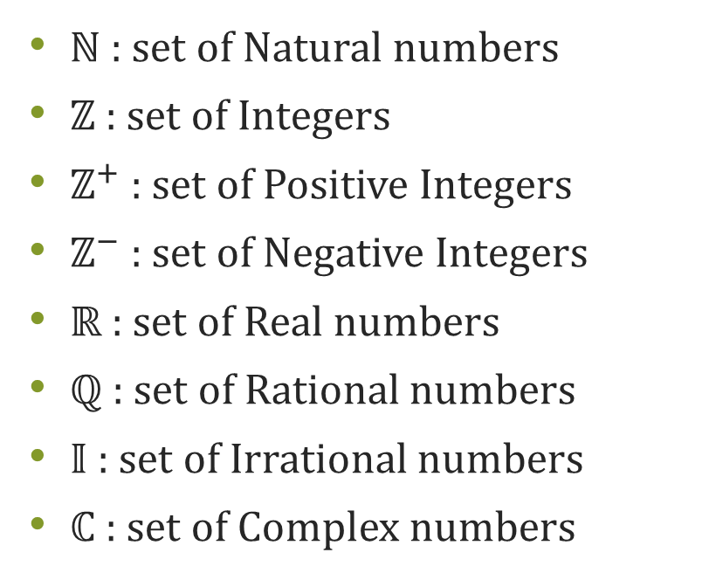
Notations
$ℕ$ : set of Natural numbers
$ℤ$ : set of Integers
$ℤ^{+}$ : set of Positive Integers
$ℤ^{−}$ : set of Negative Integers
$ℝ$ : set of Real numbers
$ℚ$ : set of Rational numbers
$𝕀$ : set of Irrational numbers
$ℂ$ : set of Complex numbers

Slide 8
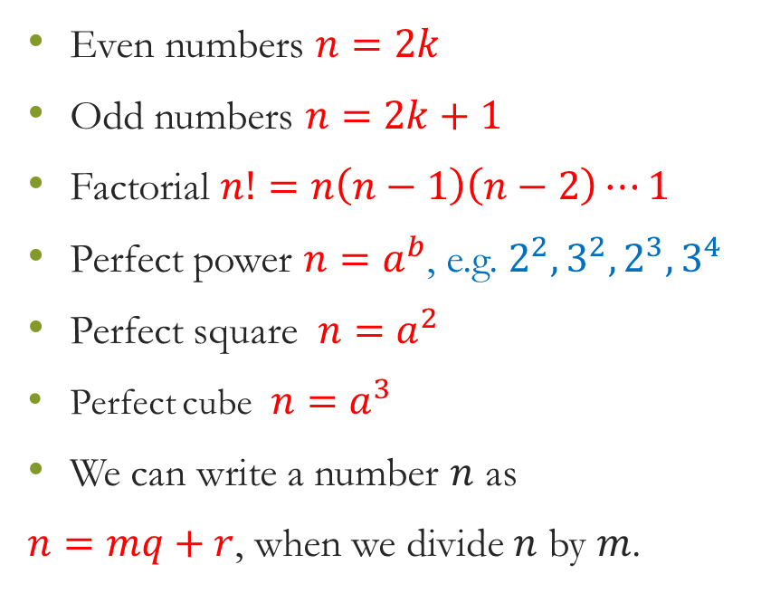
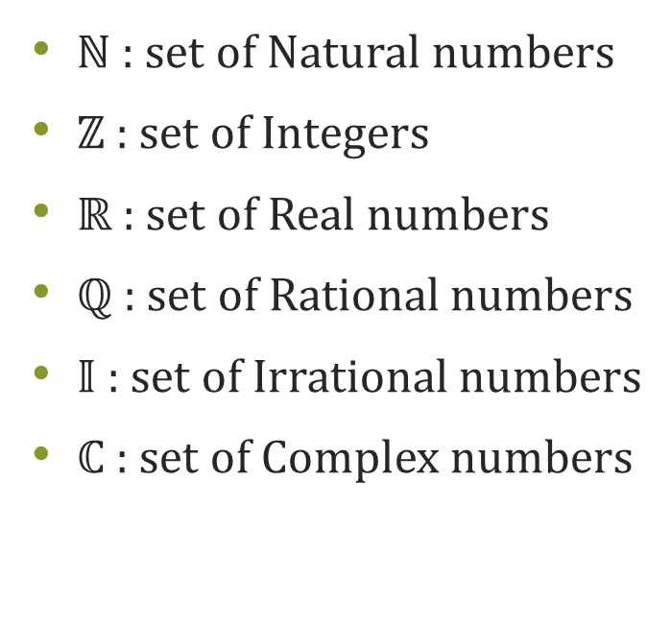
Notations
$ℕ$ : set of Natural numbers
$ℤ$ : set of Integers
$ℝ$ : set of Real numbers
$ℚ$ : set of Rational numbers
$𝕀$ : set of Irrational numbers
$ℂ$ : set of Complex numbers
Even numbers $n=2k$
Odd numbers $n=2k+1$
Factorial $n!=n\left(n−1\right)\left(n−2\right)⋯1$
Perfect power $n=a^{b}$, e.g. $2^{2}, 3^{2}, 2^{3}, 3^{4}$
Perfect square $n=a^{2}$
Perfect cube $n=a^{3}$
We can write a number $n$ as
$n=mq+r$, when we divide $n$ by $m$.

Slide 9
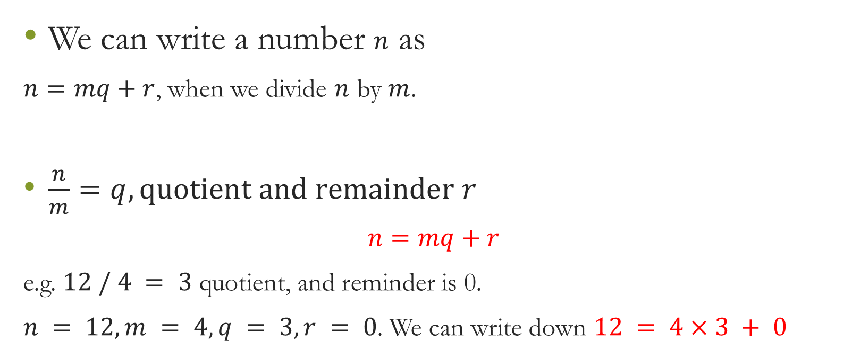
Recall
We can write a number $n$ as
$n=mq+r$, when we divide $n$ by $m$.
$\frac{n}{m}=q, quotient and remainder r$
$$n=mq+r$$
e.g. $12 / 4 = 3$ quotient, and reminder is 0.
$n = 12, m = 4, q = 3, r = 0$. We can write down $12 = 4×3 + 0$

Slide 10
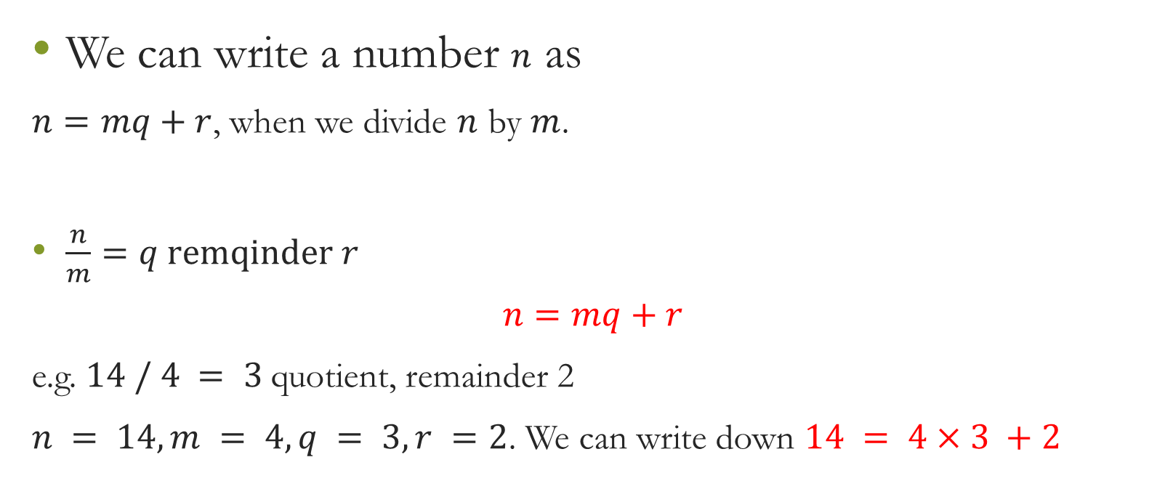
Recall
We can write a number $n$ as
$n=mq+r$, when we divide $n$ by $m$.
$\frac{n}{m}=q remqinder r$
$$n=mq+r$$
e.g. $14 / 4 = 3$quotient, remainder 2
$n = 14, m = 4, q = 3, r =2$. We can write down $14 = 4×3 +2$

Slide 11

Direct Proof (3)
Show that $0!=1$
$n!=n\left(n−1\right)\left(n−2\right)⋯1=n⋅\left(n−1\right)!$

Slide 12

Direct Proof (3)
Show that $0!=1$
$n!=n\left(n−1\right)\left(n−2\right)⋯1=n⋅\left(n−1\right)!$
$$\left(n−1\right)!=\frac{n!}{n}$$
$3!=\frac{4!}{4}=6$
$2!=\frac{3!}{3}=2$
$1!=\frac{2!}{2}=1$
$0!=\frac{1!}{1}$=1

Slide 13
Direct Proof (4)

Slide 14
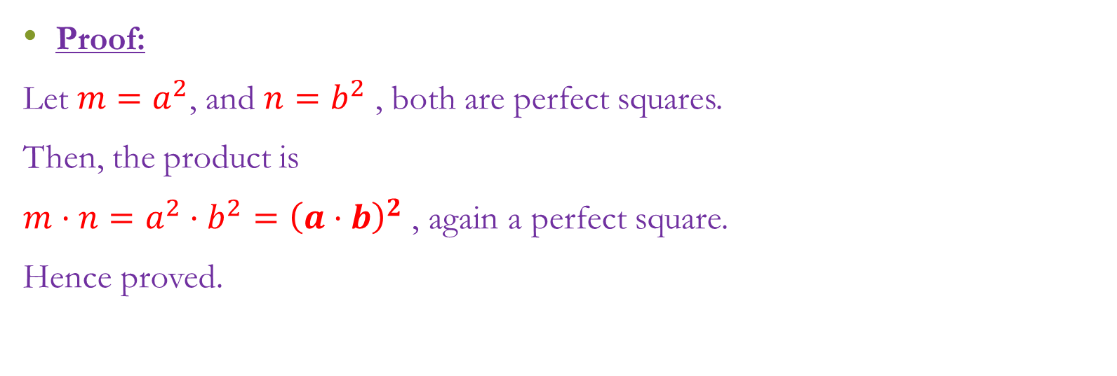
Direct Proof (4)
Proof:
Let $m=a^{2}$, and $n=b^{2}$ , both are perfect squares.
Then, the product is
$m⋅n=a^{2}⋅b^{2}={\left(a⋅b\right)}^{2}$ , again a perfect square.
Hence proved.

Slide 15

Direct Proof (5) – Exercises – (Do it by yourself)

Slide 16
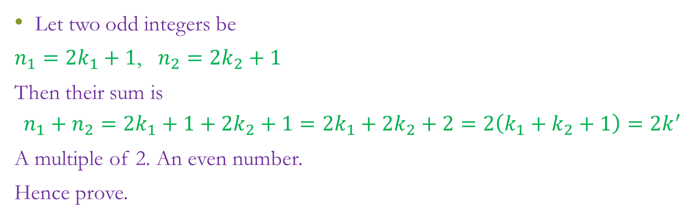
Direct Proof (5) – Exercises – (Do it by yourself)
Let two odd integers be
$n_{1}=2k_{1}+1$, $n_{2}=2k_{2}+1$
Then their sum is
$$n_{1}+n_{2}=2k_{1}+1+2k_{2}+1=2k_{1}+2k_{2}+2=2\left(k_{1}+k_{2}+1\right)=2k^{′}$$
A multiple of 2. An even number.
Hence prove.

Slide 17
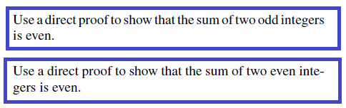
Direct Proof (5) – Exercises – (Do it by yourself)

Slide 18
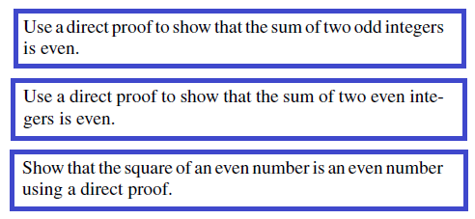
Direct Proof (5) – Exercises – (Do it by yourself)

Slide 19

Proof by Counter-Example (Disproving)

Slide 20
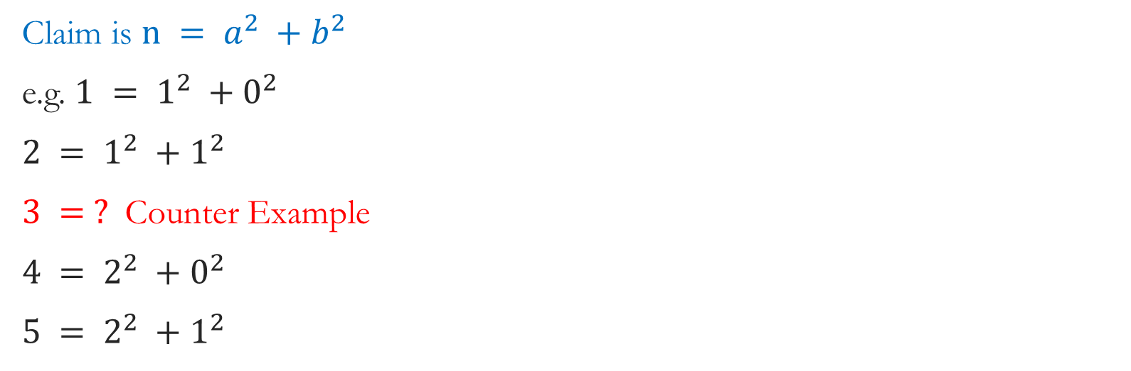
Proof by Counter-Example (Disproving)
Claim is $n = a^{2} +b^{2}$
e.g. $1 = 1^{2} +0^{2}$
$2 = 1^{2} +1^{2}$
$3 = ?$ Counter Example
$4 = 2^{2} +0^{2}$
$5 = 2^{2} +1^{2}$

Slide 21
Proof by Counter-Example – 2
All rectangles are square.

Slide 22
Proof by Counter-Example – 2
All rectangles are square
All prime numbers are odd. (Counter example: 2 is prime but even)

Slide 23

Proof by Counter-Example – 2
All rectangles are square
All prime numbers are odd.
For all integers $a$ and $b$, if $a|b$ and $b|a$, then $a = b$.

Slide 24
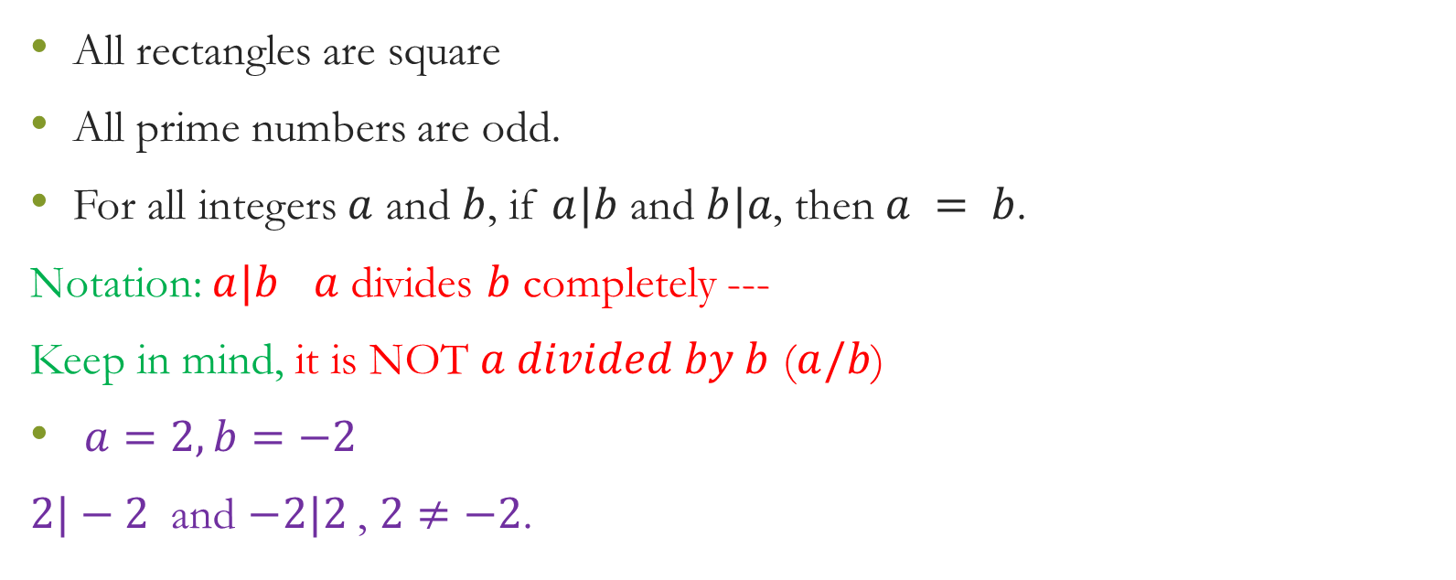
Proof by Counter-Example – 2
All rectangles are square
All prime numbers are odd.
For all integers $a$ and $b$, if $a|b$ and $b|a$, then $a = b$.
Notation: $a|b$ $a$ divides $b$ completely ---
Keep in mind, it is NOT $a divided by b$ ($a/b$)
$a=2, b=−2$
$2|−2$ and $−2|2$ , $2≠−2$.

Slide 25

What’s wrong in this Proof: $1=2$

Slide 26
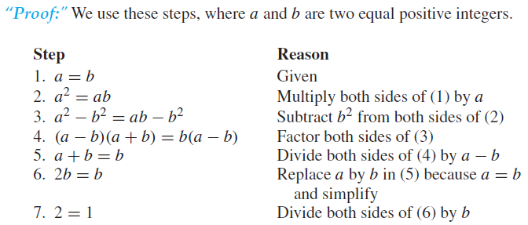
What’s wrong in this Proof: $1=2$

Slide 27
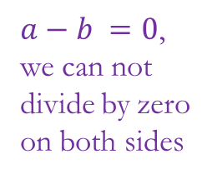
What’s wrong in this Proof: $1=2$
$a−b =0$, we can not divide by zero on both sides

Slide 28
Theorem, Lemma, Corollary
There are several common terms for a proposition that has been proved. The different terms hint at the role of the proposition within a larger body of work.
Important propositions are called theorems.
A lemma is a preliminary proposition useful for proving later propositions.
A corollary is a proposition that follows in just a few logical steps from a lemma or a theorem.

Slide 29
In Proving: NEVER TO DO things
Proofs are generalized. Never take some particular numerical values and show LHS = RHS – Always give a generalized proof
Don’t take some mathematically wrong supposition.
Avoid Circular Reasoning: Not to use the fact which you are going to prove.

Slide 30
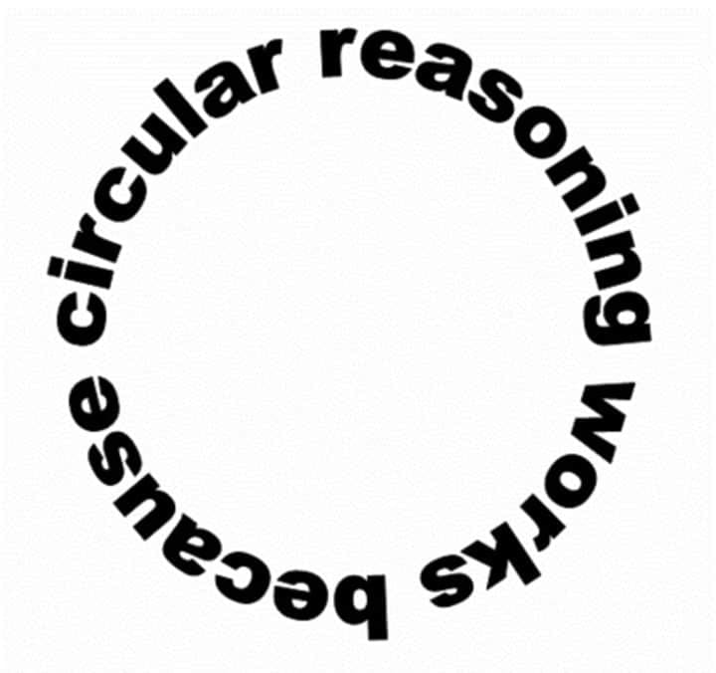
In Proving: NEVER TO DO things
Proofs are generalized. Never take some particular numerical values and show LHS = RHS
Don’t take some mathematically wrong supposition.
Avoid Circular Reasoning: Not to use the fact which you are going to prove.

Slide 31
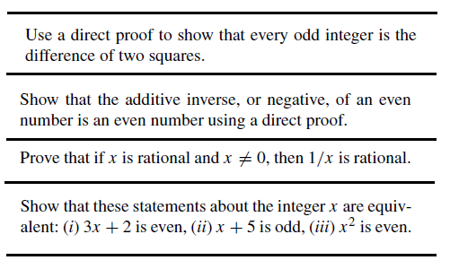
Exercises
Sum of two rational numbers is a rational number.

Slide 32
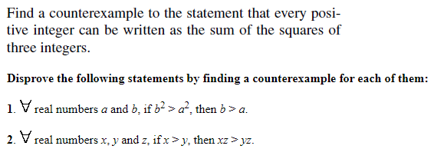
Exercises

Slide 33
How to check a number is Prime or not?
We need to check, whether a number is Prime or not.
(we did this exercise before, right?)

Slide 34

How to check a number is Prime or not?
We need to check, whether a number is Prime or not.
To prove that it is sufficient to check till $i≤\sqrt{n}$

Slide 35

How to check a number is Prime or not?
We need to check, whether a number is Prime or not.
To prove that it is sufficient to check till $i≤\sqrt{n}$
To prove, if n is not prime than $∃a:a is the smallest number, a|n$.

Slide 36
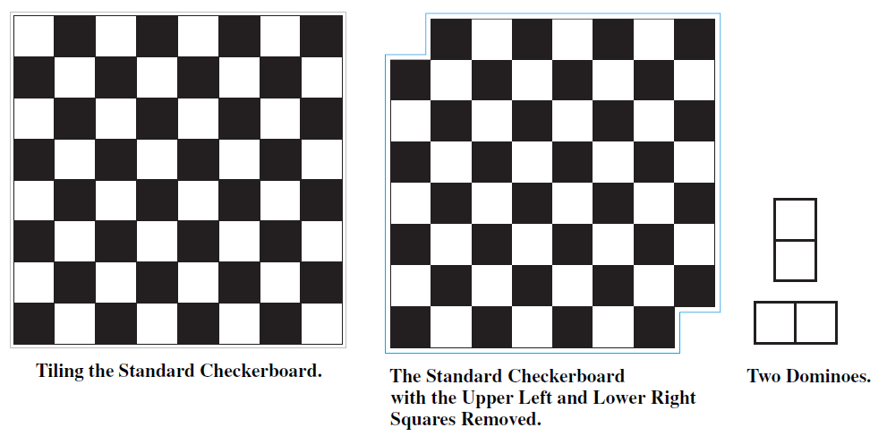
Exercises
Can we cover the modified Checker-board with dominoes? Why or why not?

Slide 37
If P is a square , then P is a rectangle.
Write Negation:

Slide 38

Inverse and Negation are 2 different things
$p→q$
Inverse: $¬p→ ¬ q$
Negation: $¬\left(p→q\right)≡p∧¬q$
If P is a square , then P is a rectangle.
Negation: P is a square and P is NOT a rectangle.

